Slide 1
HPE CPP PROJECT REVIEW
CLASSIFY VARIOUS SPECIES OF ANIMALS IN FOREST USING CAMERA TRAPS
.
Aastha Priya Bhupendra Singh Mahika D Monish P Vedith Varma
Under the guidance of
Praveen Avrur, Expert Engineer, HPE.
Dr. Shyamala G, Associate Professor, Department of CSE, B.M.S. College of Engineering.
Sunayana S, Assistant Professor, Department of CSE, B.M.S. College of Engineering.

Slide 2
INTRODUCTION
Earth hosts diverse ecosystems supporting millions of plant and animal species.
Wildlife plays a key role in maintaining ecological balance (e.g., seed dispersal, predator-prey control).
Human activities like deforestation and urbanization threaten biodiversity.
Conservation efforts include national parks, wildlife sanctuaries, and biosphere reserves.
Camera traps help monitor wildlife in natural habitats non-invasively.
Millions of images captured require efficient processing and species identification.
Manual image labeling is time-consuming, error-prone, and inconsistent.
Deep learning offers potential to automate and improve wildlife image classification.

Slide 3
PROBLEM STATEMENT
Based on a review of recent wildlife monitoring practices using camera traps and deep learning techniques, the following problem has been identified:
“Despite the widespread use of camera traps in wildlife monitoring, the enormous volume of image data—often containing a high percentage of empty frames and imbalanced species representation—poses significant challenges for manual classification and analysis. Small-sized and rare animal species are particularly underrepresented, leading to poor classification accuracy and biased deep learning models. Manual annotation is time-consuming, prone to human error, and not scalable. Therefore, there is a critical need for automated, accurate, and efficient methods to classify camera trap images, especially to improve detection and identification of smaller species using advanced deep learning techniques and data preprocessing strategies.”

Slide 4
OBJECTIVES OF THE PROJECT
To improve the classification accuracy of small animals in camera trap images using deep learning and data preprocessing techniques.
To suggest a suitable deep learning model that achieves 90%-95% accuracy for small animal classification.
To enable identification of both the number and types of animals present in each image.
To demonstrate object identification techniques that can be applied by students and researchers in wildlife monitoring.

Slide 5
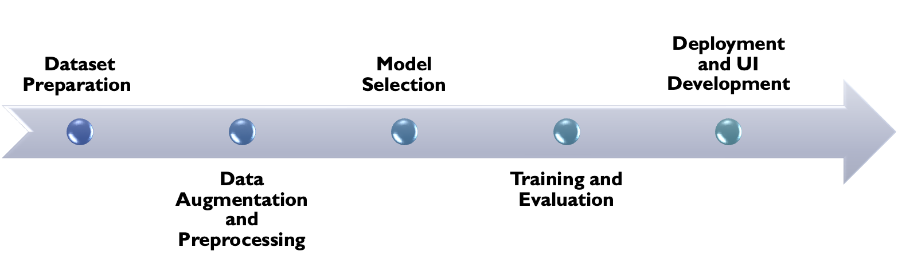
SOLUTION APPROACH

Slide 6
DATASET PREPARATION
Collected images for 40 species, including empty images
Images sourced from:
Snapshot Safari 2024 Expansion
WCS Camera Traps
Each class had approximately 1500 images .The total number of unique images across all species is 58,209.
Tried class balancing across different lighting conditions: Morning, Dusk, Dawn, and Night for some species.
Applied image augmentation to increase diversity for each species
Generated YOLO-format labels with bounding boxes for all images

Slide 7
SEGREGATION OF SPECIES FOR ACCURACY EVALUATION
To assess whether our model achieves higher accuracy specifically for smaller animal species, which are traditionally harder to detect and classify due to their size and lower representation in the dataset.
We used body weight and height as the primary parameters for categorizing the species into two distinct groups:
Small Species:
Body weight: Under 20 kilograms
Height: Under 60 centimeters
These typically include animals that are less prominent in size and are often underrepresented in training data.
Large Species:
Body weight: Over 20 kilograms
Height: Over 60 centimeters
These animals are more likely to be well-captured in images and thus typically easier to classify.
This categorization helps us isolate performance gains specifically for smaller species.

Slide 8
SEGREGATED SPECIES
Small Species (Under 20 kg body weight and under 60 cm height):
- Agouti
- Bushbuck
- Collared_peccary
- Common_opossum
- Guineafowl
- Hare
- Mountain_squirrel
- Ocelot
- Paca
- Porcupine
- Red_brocket_deer
- Red_squirrel
- Tinamou
- White_nosed_coati
- Monkeyvervet
- Mongoose
Large Species (Over 20 kg body weight and over 60 cm height):
- Baboon
- Buffalo
- Eland
- Elephant
- Giraffe
- Hippopotamus
- Impala
- Lion_female
- Lion_male
- Reedbuck
- Warthog
- Waterbuck
- White_tailed_deer
- Wild_boar
- Aardwolf
- Hyena_spotted
- Rhinocerosblack
- Rhinoceroswhite
- Topi
- Jackalblackbacked
- Wildebeestblack
- Nyala

Slide 9
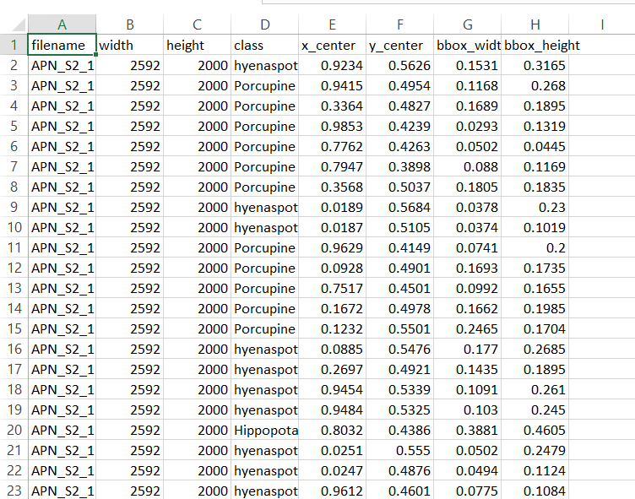
METADATA
Used to generate .txt annotation files for YOLOv8
Each .txt file matches an image and contains object info
Includes species label and bounding box coordinates
Bounding boxes are normalized (x_center, y_center, width, height)
Supports multiple animals per image

Slide 10
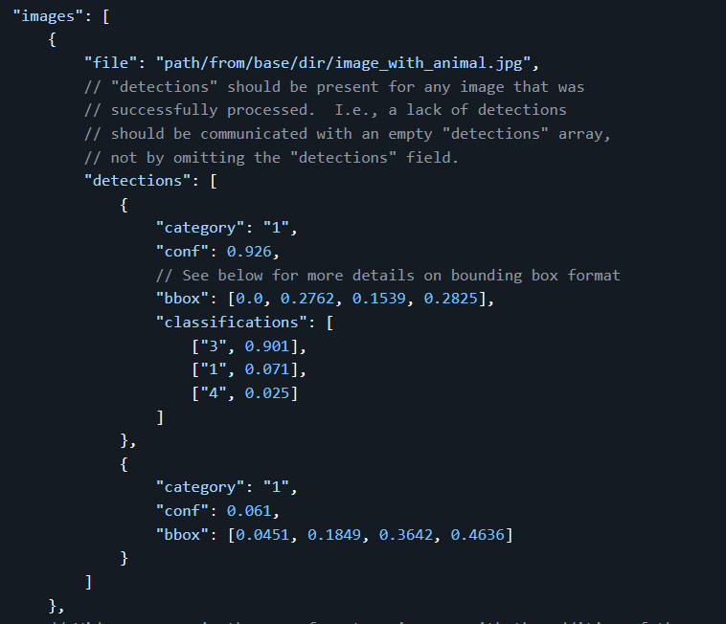
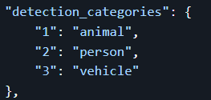
MDV5 ANNOTATIONS FILE

Slide 11
NEED FOR ADDRESSING UNDERREPRESENTED DATA
Small animal species are significantly underrepresented in the dataset compared to larger species.
Imbalanced data can lead to biased models favoring dominant classes.
The scarcity of small animal images limits the model’s ability to learn distinguishing features.
Augmentation techniques help replicate variations of small animal images to increase their representation.
This improves classification performance and ensures the model generalizes better to all species.
Augmentation helps simulate real-world diversity and enhances detection of low-frequency classes.

Slide 12
DATA AUGMENTATION AND PREPROCESSING
Image Augmentation :
We applied data augmentation to species with fewer than 1500 images to balance the dataset.
Each image’s bounding boxes were preserved and updated in YOLO format after augmentation.
The type of augmentation depended on the size of animals (bounding boxes) in the image.
Augmentation Strategy :
For images with small animals, we used mild augmentations like horizontal flip, brightness adjustment, and CLAHE to avoid distorting important features.
For medium or large animals, we applied stronger transformations including flips, color changes, rotations, and Gaussian noise.

Slide 13
AUGMENTATION TECHNIQUES
Horizontal Flip
→ Flips the image from left to right to simulate different viewpoints.
Vertical Flip
→ Flips the image upside-down to increase orientation diversity (used less frequently).
Brightness and Contrast Adjustment
→ Simulates lighting changes during different times of day.
Color Jitter
→ Randomly changes brightness, contrast, saturation, and hue to create varied visual conditions.

Slide 14
Rotation
→ Rotates the image to make the model robust to camera angle variations.
CLAHE (Contrast Limited Adaptive Histogram Equalization)
→ Enhances local contrast while avoiding noise amplification — useful for night or low-light images.
Gaussian Noise
→ Adds subtle noise to simulate sensor imperfections or low-quality captures..

Slide 15
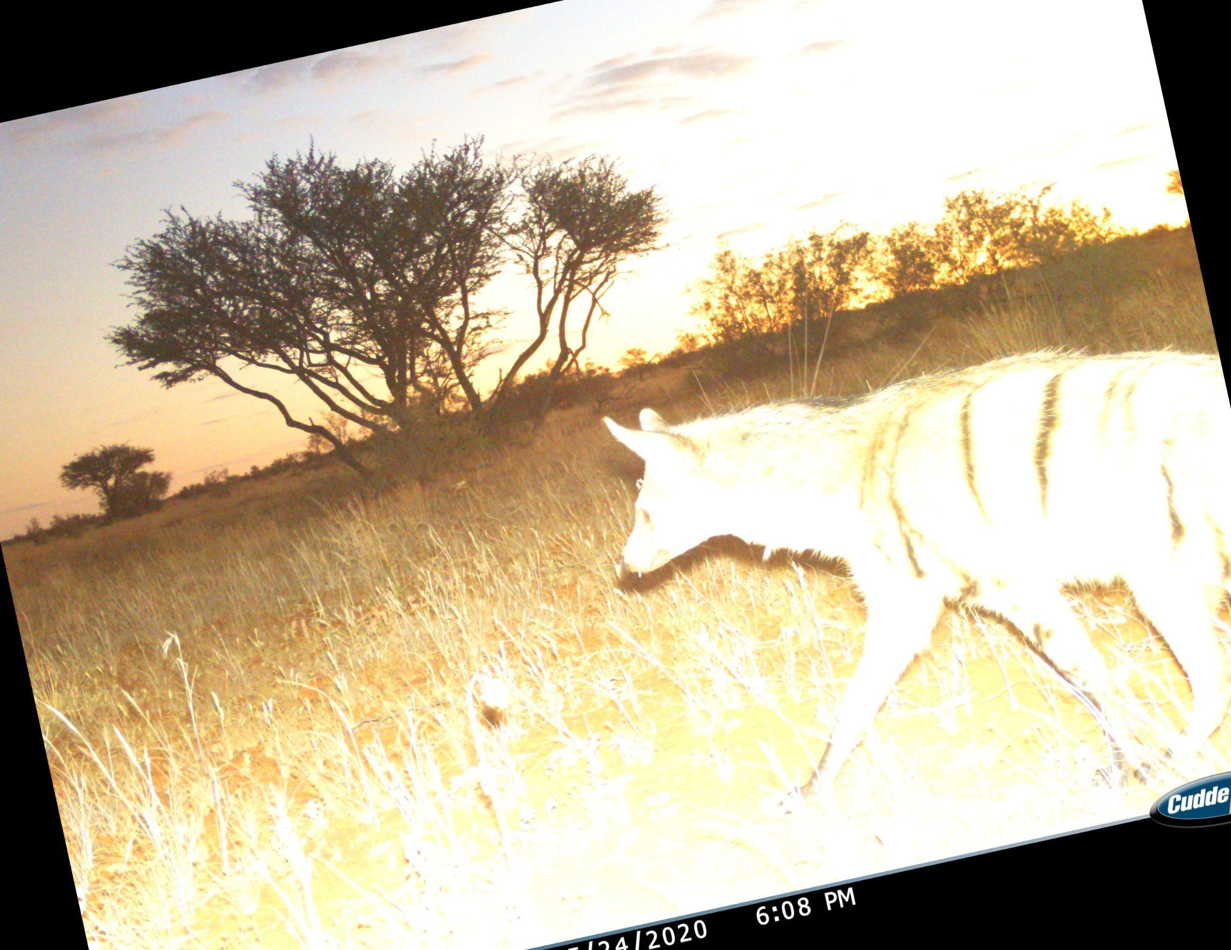
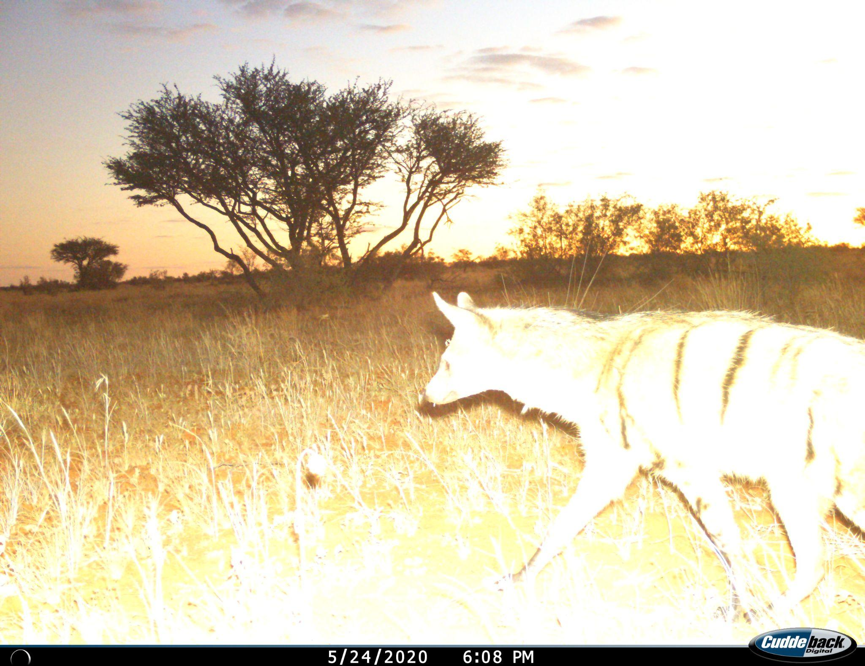
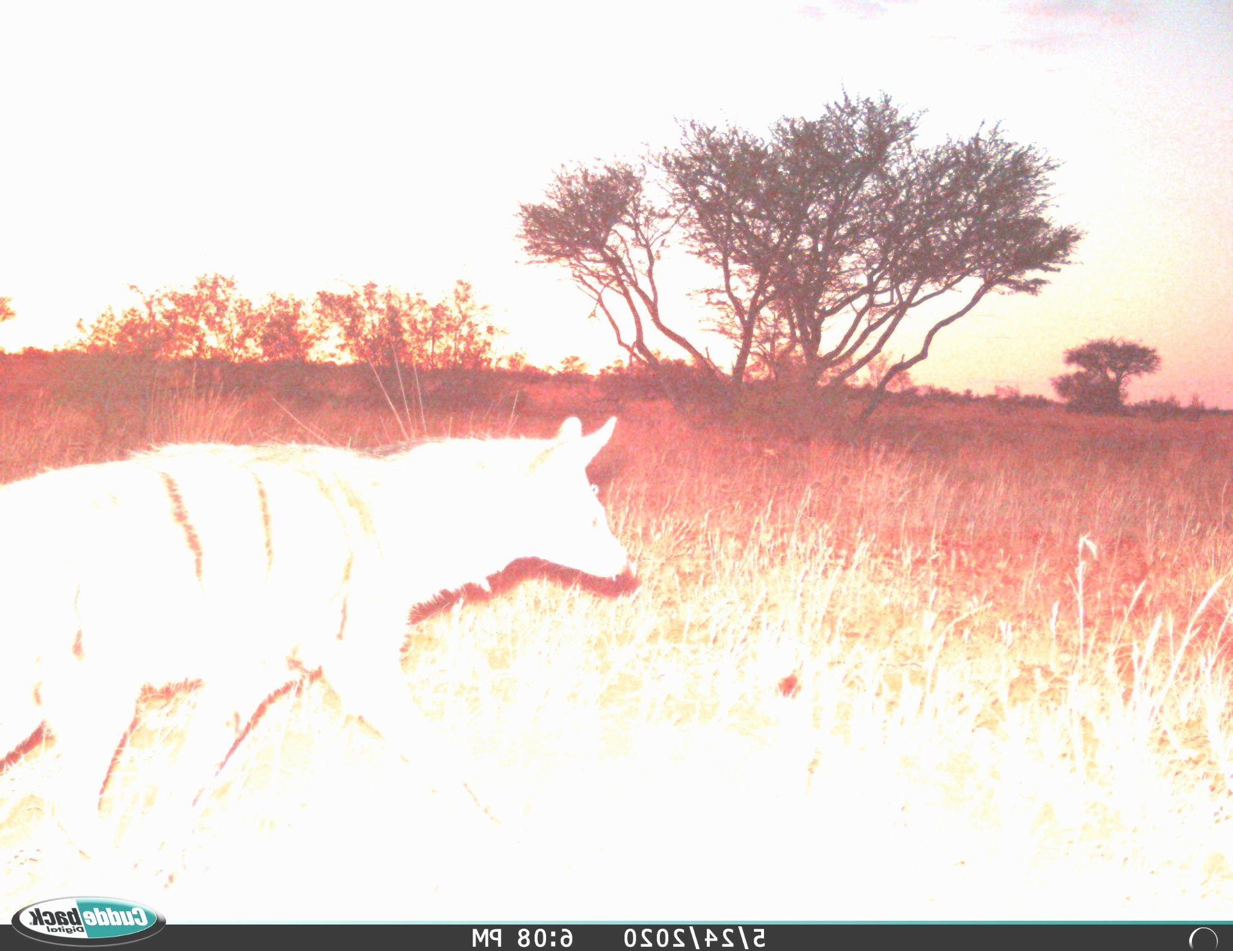
DATA AUGMENTATION EXAMPLES

Slide 16
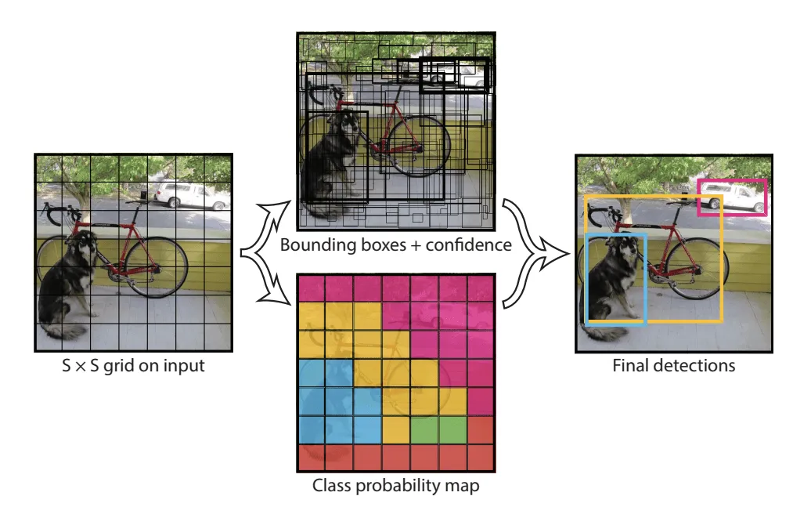
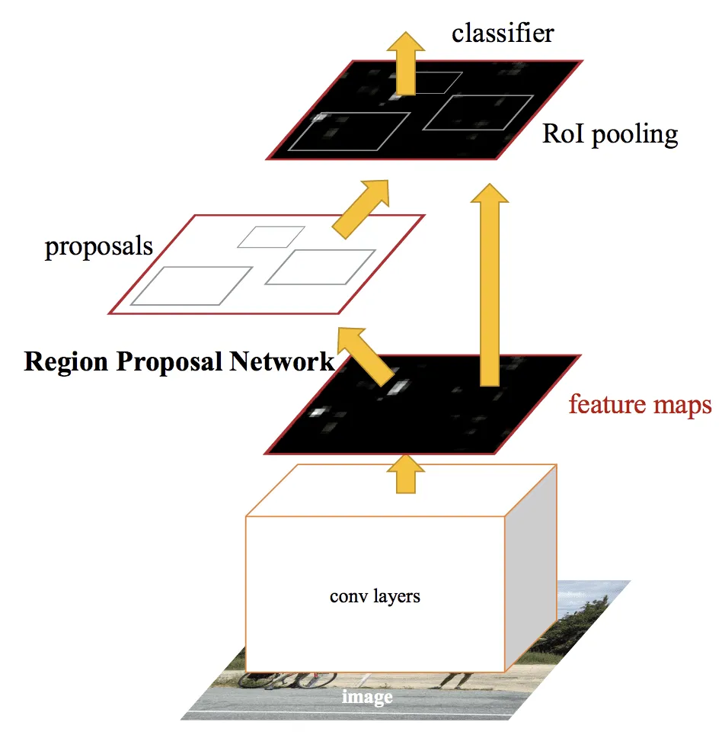
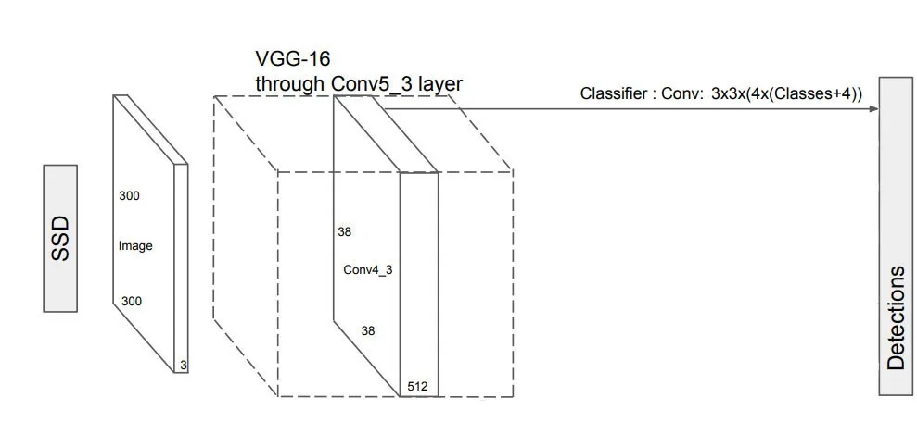
MODEL SELECTION
YOLO
Faster R-CNN
SSD

Slide 17
MODEL SELECTION
Faster R-CNN | YOLO | SSD
Two-Stage Detector | Single Shot Detector | Single Shot Detector
Has 2 components: an RPN(Region Proposal Network) which proposes the region as well as the type of object to consider and a Fast R-CNN for extracting features from the proposed region and outputting labels and bboxes. | Divides an image into grid of cells and each cell predicts a bbox coordinates with class and confidence. | Has no delegated region proposal network and predicts the boundary boxes and the classes directly from feature maps in one single pass.

Slide 18
MODEL SELECTION
Model | Complexity | Speed | Accuracy | Efficiency
Faster R-CNN | High | Slow | High | Less efficient
YOLO | Medium | Fast | Medium | Efficient
SSD | Low | Fast | High | Efficient

Slide 19
MODEL SELECTION
Model | Frames Per Second (FPS)
YOLOv8 | 40-155
SSD | 22-46
Faster R-CNN | 5-7

Slide 20
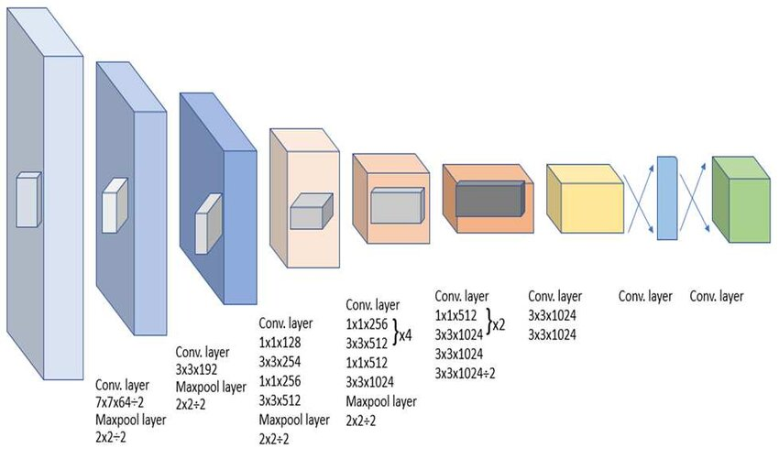
MODEL SELECTION
While SSD offers overall better accuracy and strikes a delicate balance between speed and accuracy, when dealing with objects that are extremely close or unusually small, SSDs might struggle to accurately detect them.
While YOLO does sacrifice its accuracy for speed, it is still reliable as YOLO could be a higher choice even when the object size is small. YOLOv8 is renowned for its exceptional speed in object detection tasks.
With the capability to process images at a high FPS rate, YOLOv8 is ideal for real-time applications where real-time analysis is crucial.

Slide 21
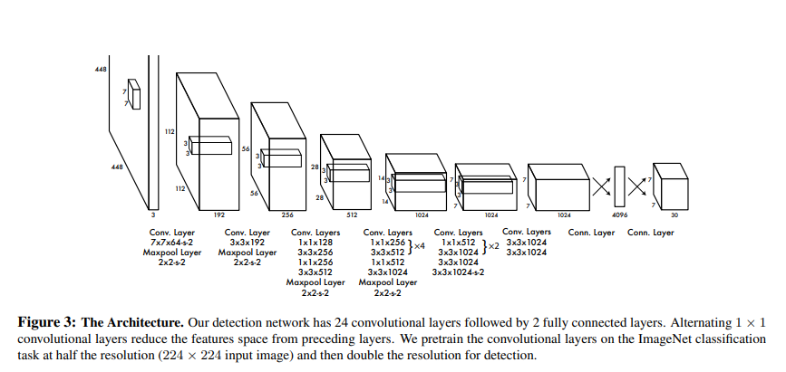
YOLO ARCHITECTURE

Slide 22
YOLO MODEL EVALUATION METRICS
Intersection over Union (IoU): IoU is a measure that quantifies the overlap between a predicted bounding box and a ground truth bounding box. It plays a fundamental role in evaluating the accuracy of object localization.
Average Precision (AP): AP computes the area under the precision-recall curve, providing a single value that encapsulates the model's precision and recall performance.
Mean Average Precision (mAP): mAP extends the concept of AP by calculating the average AP values across multiple object classes. This is useful in multi-class object detection scenarios to provide a comprehensive evaluation of the model's performance.
Precision and Recall: Precision quantifies the proportion of true positives among all positive predictions, assessing the model's capability to avoid false positives. On the other hand, Recall calculates the proportion of true positives among all actual positives, measuring the model's ability to detect all instances of a class.
F1 Score: The F1 Score is the harmonic mean of precision and recall, providing a balanced assessment of a model's performance while considering both false positives and false negatives.
Class: This denotes the name of the object class, such as "person", "car", or "dog".
Images: This metric tells you the number of images in the validation set that contain the object class.
Instances: This provides the count of how many times the class appears across all images in the validation set.
Box(P, R, mAP50, mAP50-95): This metric provides insights into the model's performance in detecting objects:
P (Precision): The accuracy of the detected objects, indicating how many detections were correct.
R (Recall): The ability of the model to identify all instances of objects in the images.
mAP50: Mean average precision calculated at an intersection over union (IoU) threshold of 0.50. It's a measure of the model's accuracy considering only the "easy" detections.
mAP50-95: The average of the mean average precision calculated at varying IoU thresholds, ranging from 0.50 to 0.95. It gives a comprehensive view of the model's performance across different levels of detection difficulty.

Slide 23
MODEL TRAINING
We trained three YOLOv8 models with progressively increasing image sizes and species coverage, balancing performance with available computational resources:
Model | YOLO Version | Image Size | Epochs | Species | Remarks
Model 1 | YOLOv8n (Nano) | 416 × 416 | 50 | 36 | Lightweight, fast training, fewer species for quick baseline
Model 2 | YOLOv8m (Medium) | 640 × 640 | 35 | 36 | Balanced trade-off between accuracy and speed
Model 3(final) | YOLOv8l (Large) | 960 × 960 | 50 | 40 | Higher accuracy, covers more species, longer training time

Slide 24
MODEL 1: TRAINING (YOLO v8n - Image Size 416x416)
The model was trained for a total of 50 epochs.
Loss values are steadily decreasing across the epochs, which indicates that the model is improving its learning and fitting the training data.
Metrics like precision, recall, and mAP are increasing, meaning the model's ability to correctly identify and classify objects is improving over time.
Learning rate is gradually being reduced, which is typical for many optimization strategies like learning rate schedulers to help the model converge.

Slide 25
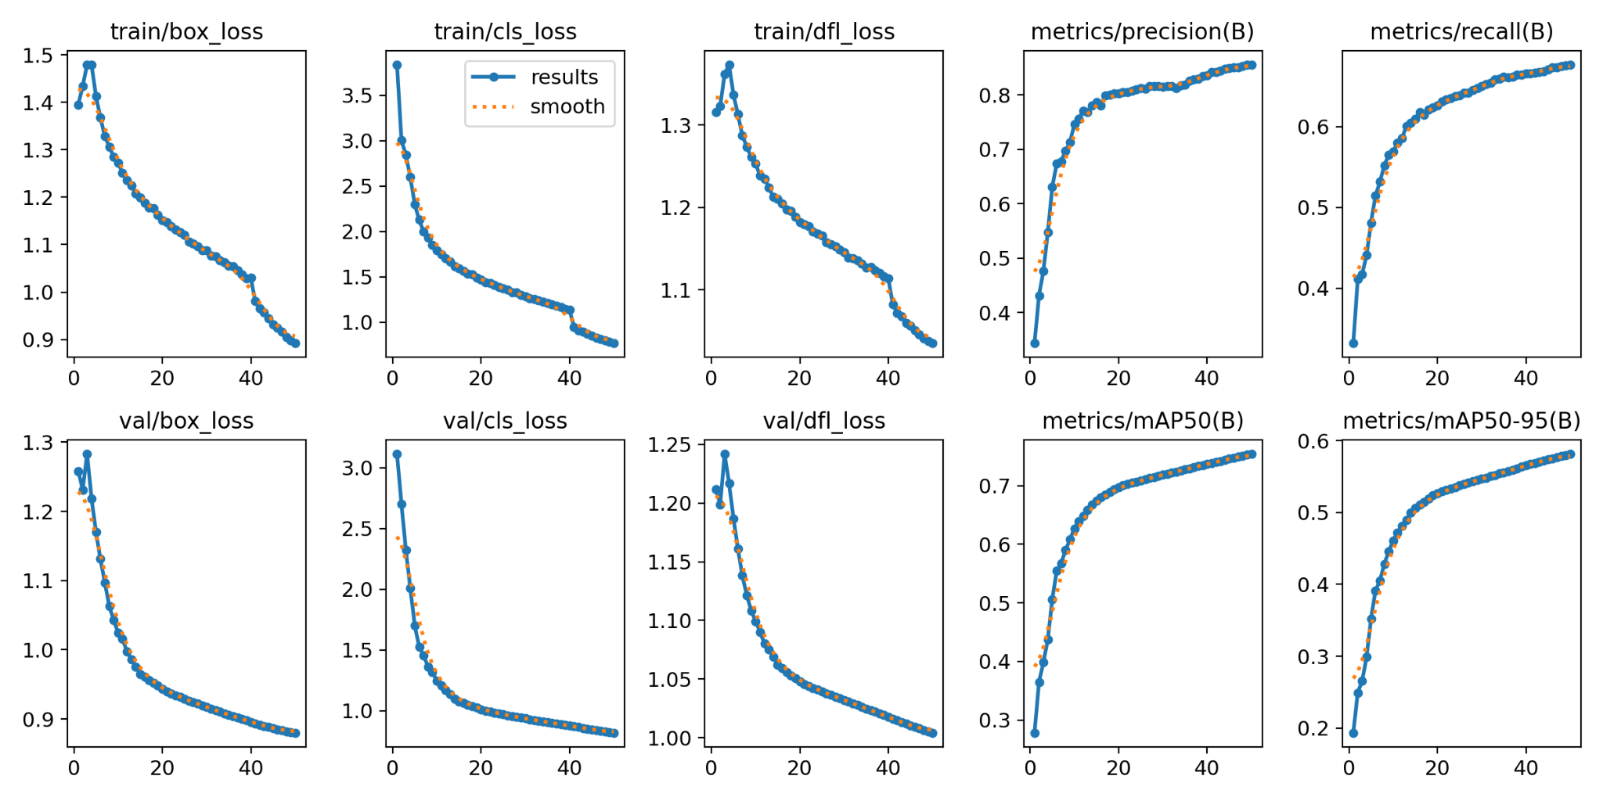
MODEL 1: TRAIN AND VAL RESULTS

Slide 26
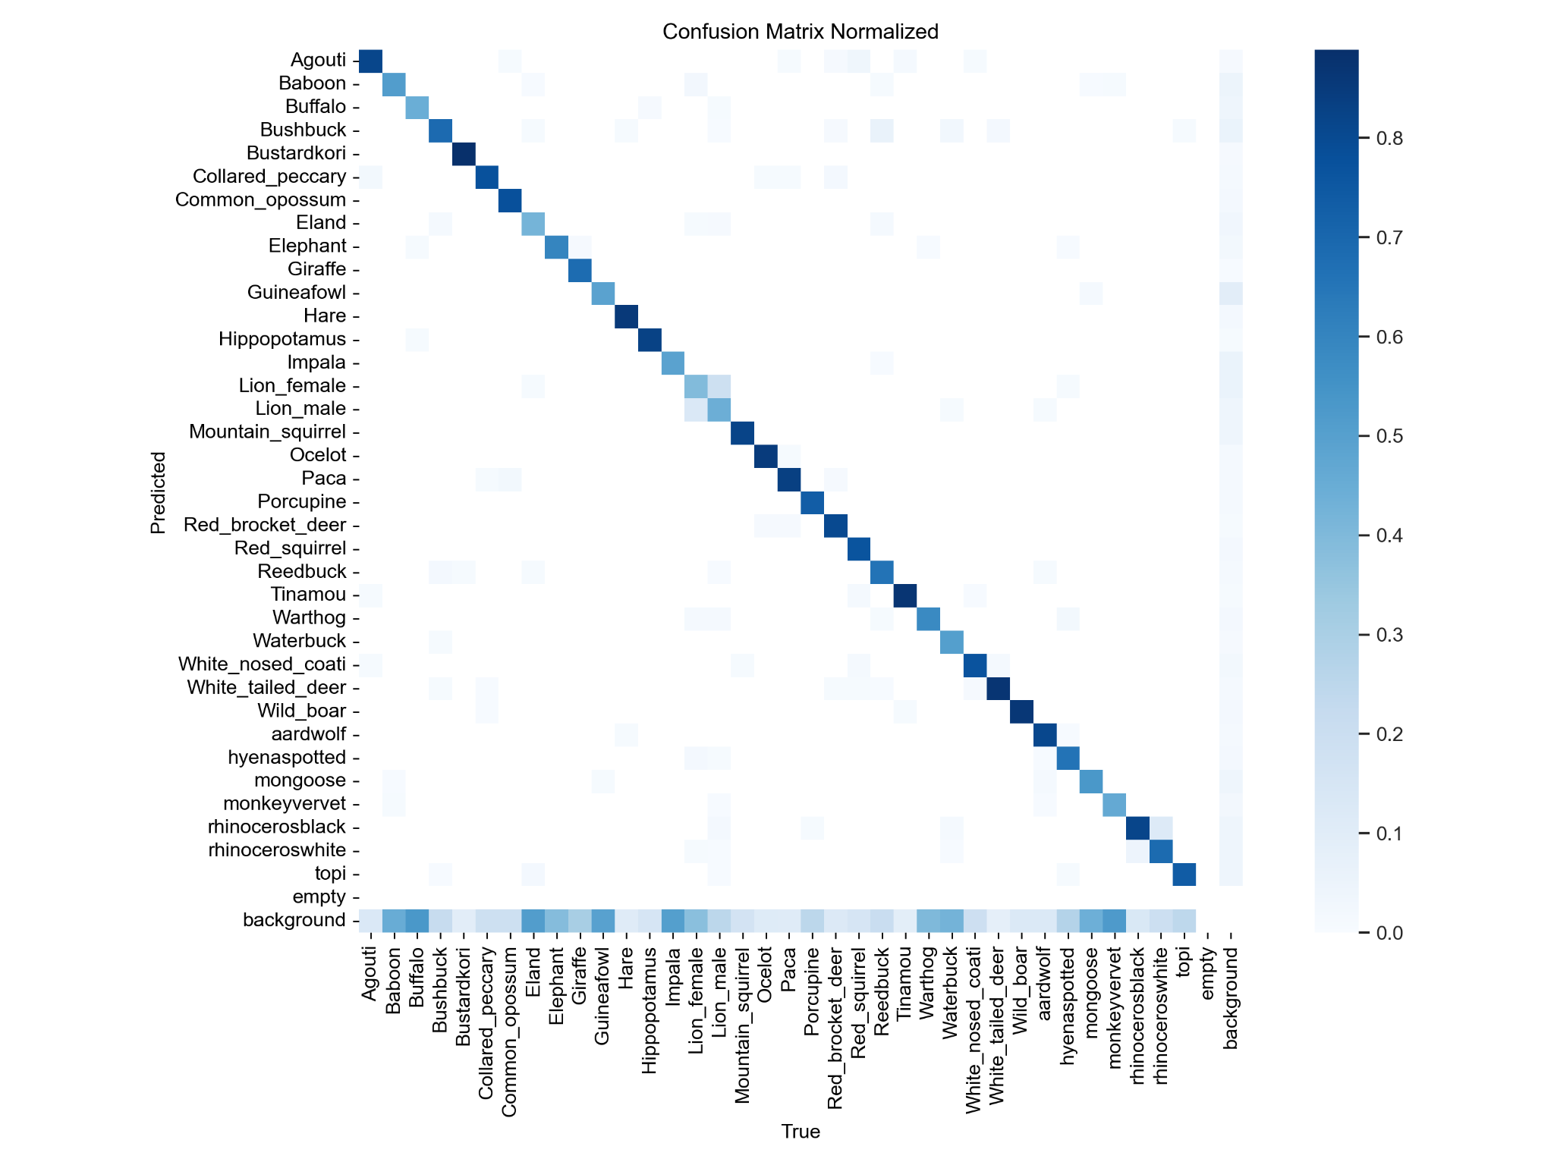
MODEL 1: CONFUSION MATRIX

Slide 27
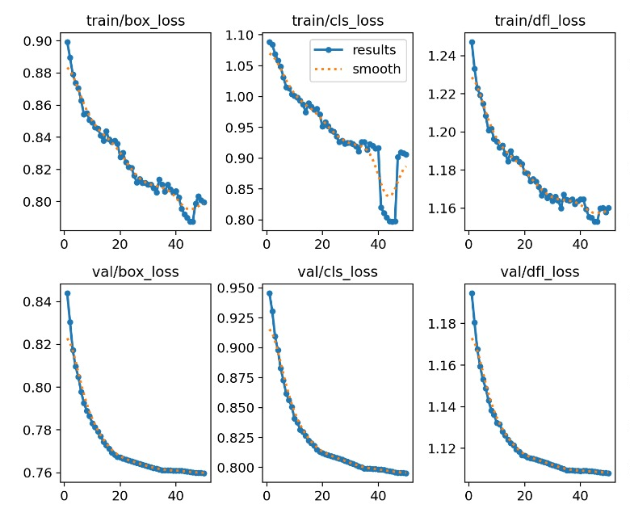
INSIGHTS AND LEARNINGS FROM THE MODEL 1
Version: Nano
Image Size: 960
As shown in the graph the model reached 0.80 map50 at the end of 50 epochs. However, the classification loss begins to increase with insignificant improvements in accuracy indicating overfitting of the model on the training data.

Slide 28
MODEL 2: TRAINING (YOLOv8m - Image Size 640x640)
Training: 30 epochs at 640 resolution — faster convergence compared to prior 50-epoch run.
Learning Behavior: All losses reduce smoothly and validation trends match training closely indicating no signs of overfitting.
Precision & Recall: High precision (~0.91) and steadily improving recall (~0.78) indicating robust and confident detection.
mAP: Strong performance on both mAP50 (~0.85) and mAP50-95 (~0.73) which signifies excellent balance of accuracy and localization.
Overall: The model shows high-quality learning in fewer epochs, likely due to better training configuration.

Slide 29
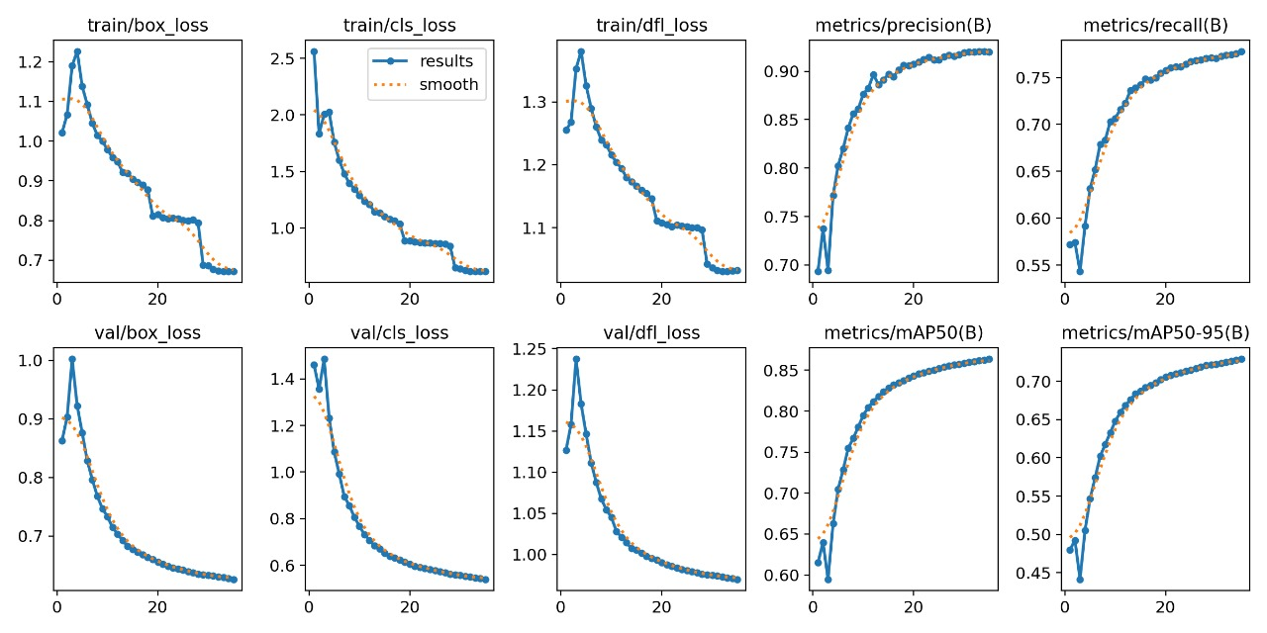
MODEL 2: TRAIN AND VAL RESULTS (Image Size 640x640)

Slide 30
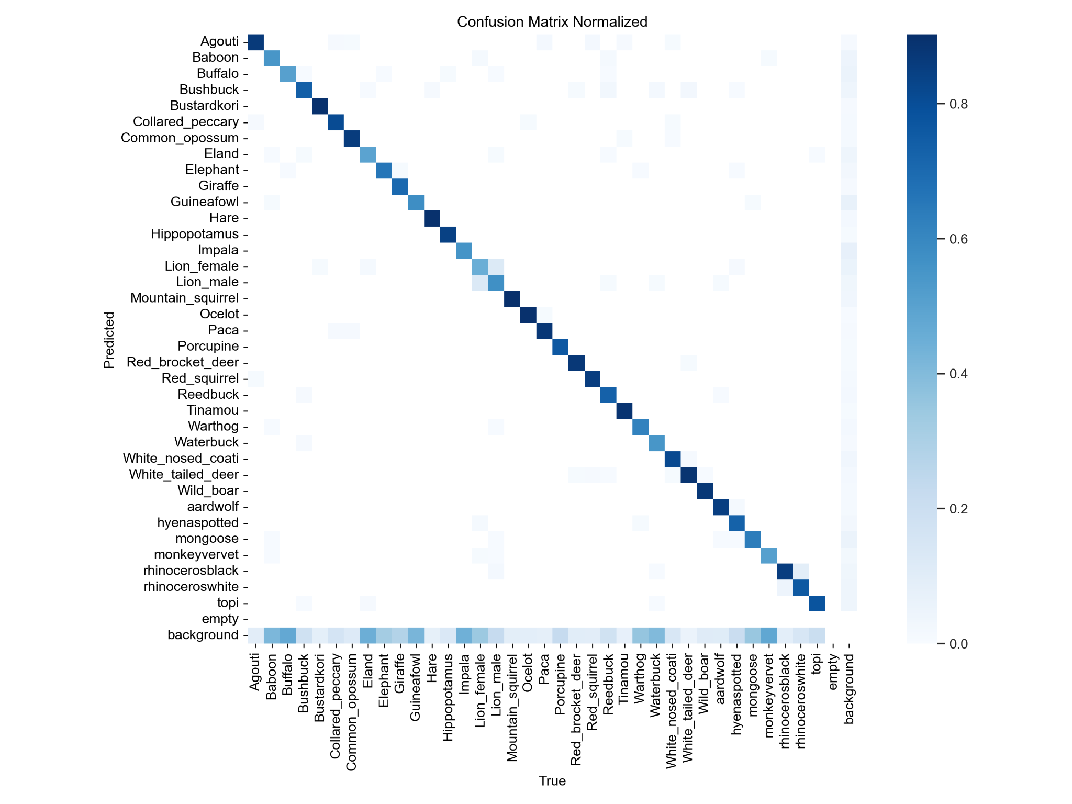
MODEL 2: CONFUSION MATRIX (Image Size 640x640)

Slide 31
DRAWBACKS AND LEARNINGS FROM MODEL 2
Drawbacks
Despite overall improvements, the model did not achieve the targeted mAP-50 score for smaller species, which remains around 0.75–0.80.
As a result, the primary objective of accurately detecting small species was not fully met.
Additionally, the overall mAP-50 performance of the model fell short of the desired benchmark.
Learnings
To reach the desired mAP-50 score of 0.90–0.95 for small species, increasing the input image resolution is essential, as it helps preserve finer details.
The overall model accuracy (mAP-50) can be improved by:
Using a more advanced or larger model variant (e.g., YOLOv8l or YOLOv8x).
Training for more epochs, allowing the model to learn more complex patterns and improve generalization.

Slide 32
MODEL 3: TRAINING (YOLOv8l - Image Size 960x960)
Training The model was trained for 50 epochs at a 960x960 resolution, resulting in longer epoch times (~14,115 seconds per epoch).
Loss Metrics Training losses steadily decreased by epoch 50: box loss 0.55, classification loss 0.50, and DFL loss 1.02, indicating stable convergence.
Validation Validation losses remained low and close to training losses: box loss 0.52, classification loss 0.46, and DFL loss 0.97, showing good generalization.
Performance At epoch 50, the model achieved precision 0.93, recall 0.82, mAP50 0.90, and mAP50-95 0.79, demonstrating strong detection and classification accuracy.
Stability Loss and metric curves were smooth and consistent, confirming reliable and stable training.
Trade-off Higher accuracy and generalization were achieved with increased computation time, suitable for production with hardware considerations.

Slide 33
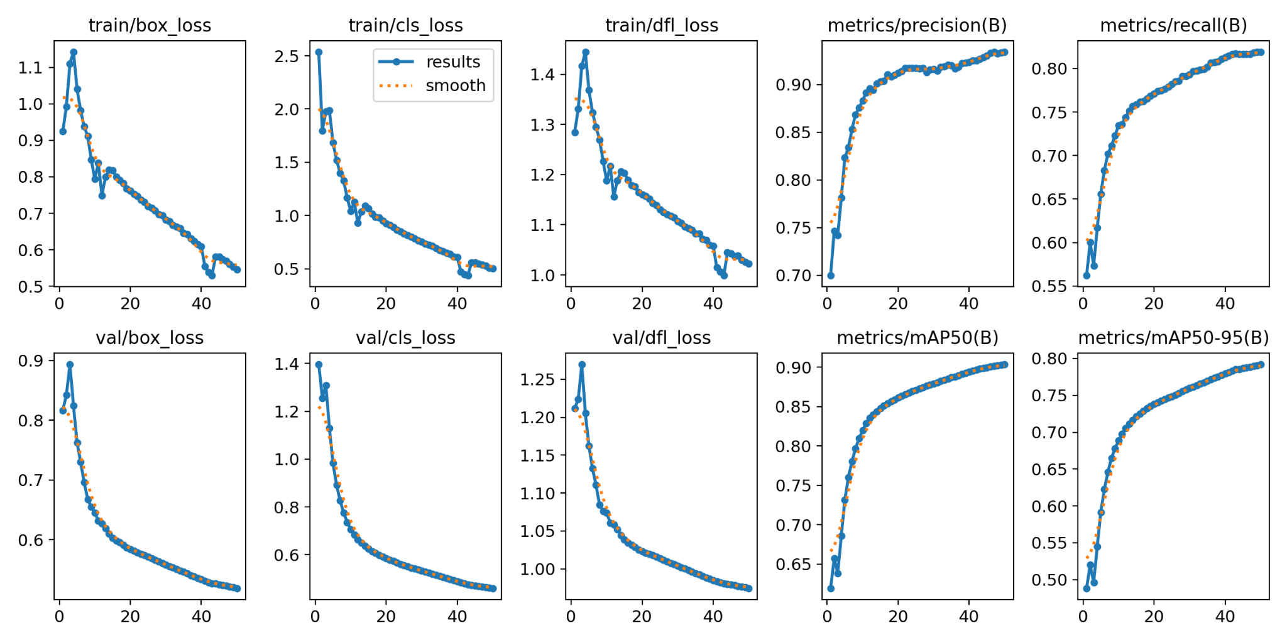
MODEL 3: TRAIN AND VAL RESULTS (Image Size 960x960)

Slide 34
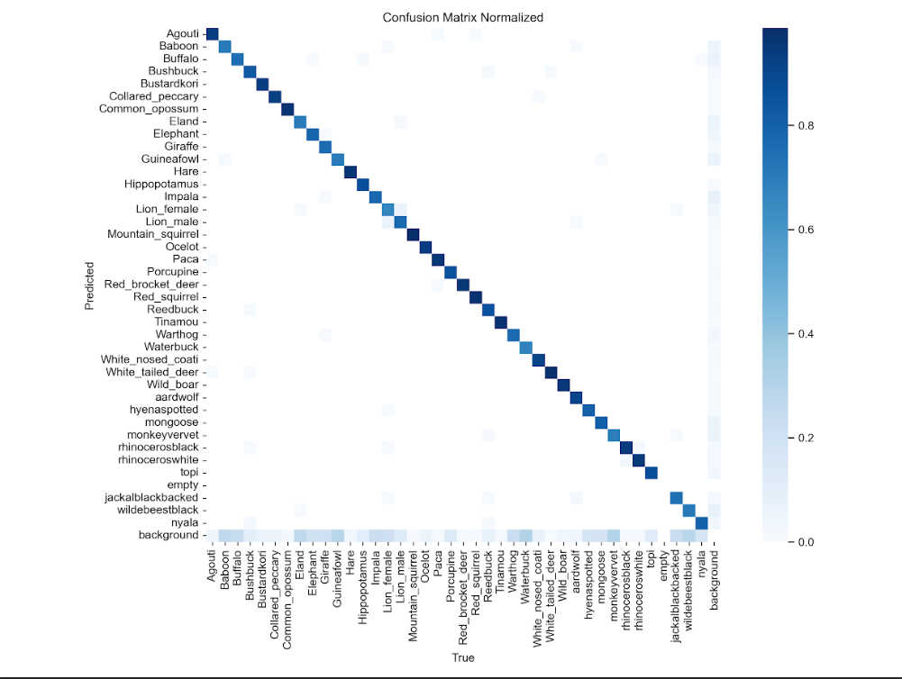
MODEL 3: CONFUSION MATRIX (Image Size 960x960)

Slide 35
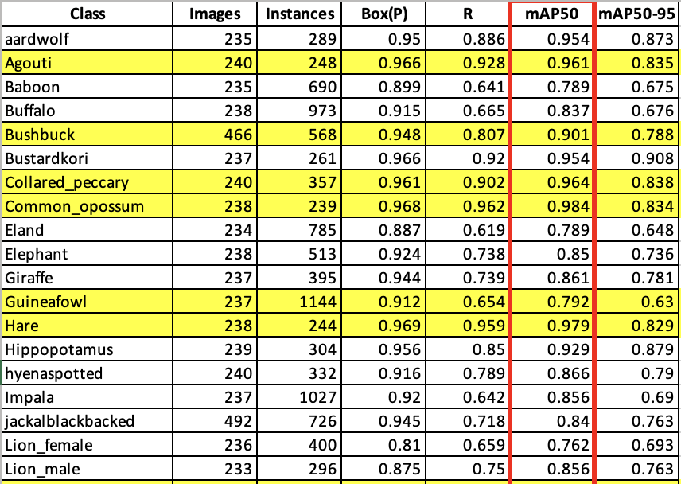
ACHIEVED METRICS FOR EACH SPECIES

Slide 36
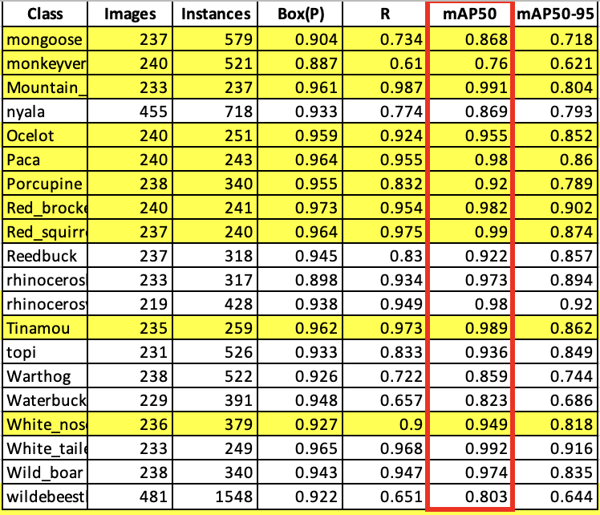
ACHIEVED METRICS FOR EACH SPECIES

Slide 37
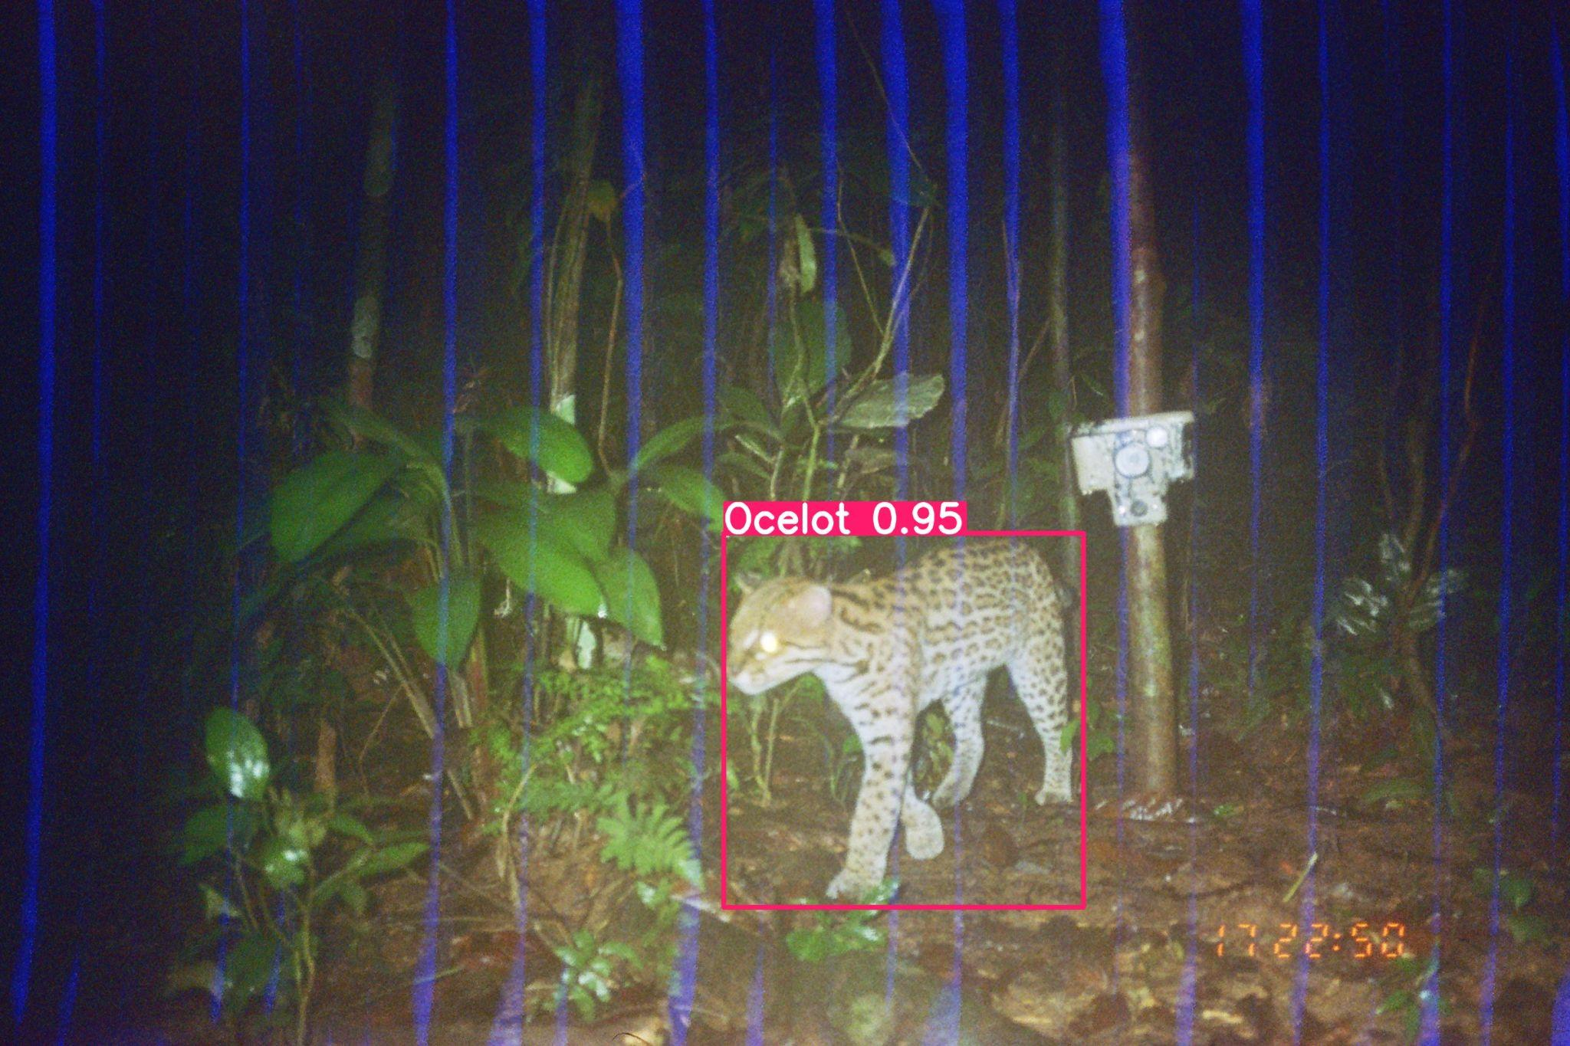
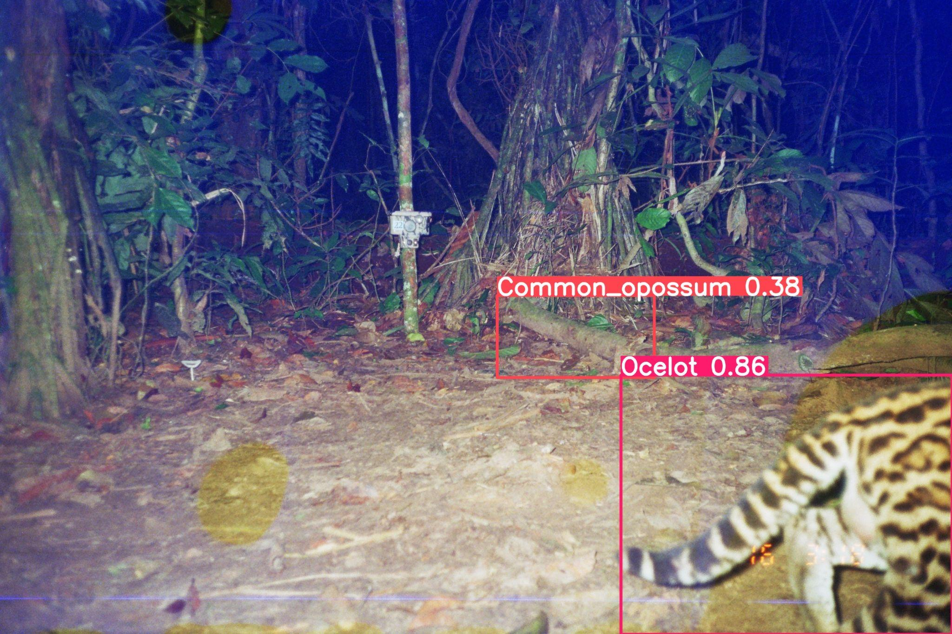
RESULTS

Slide 38
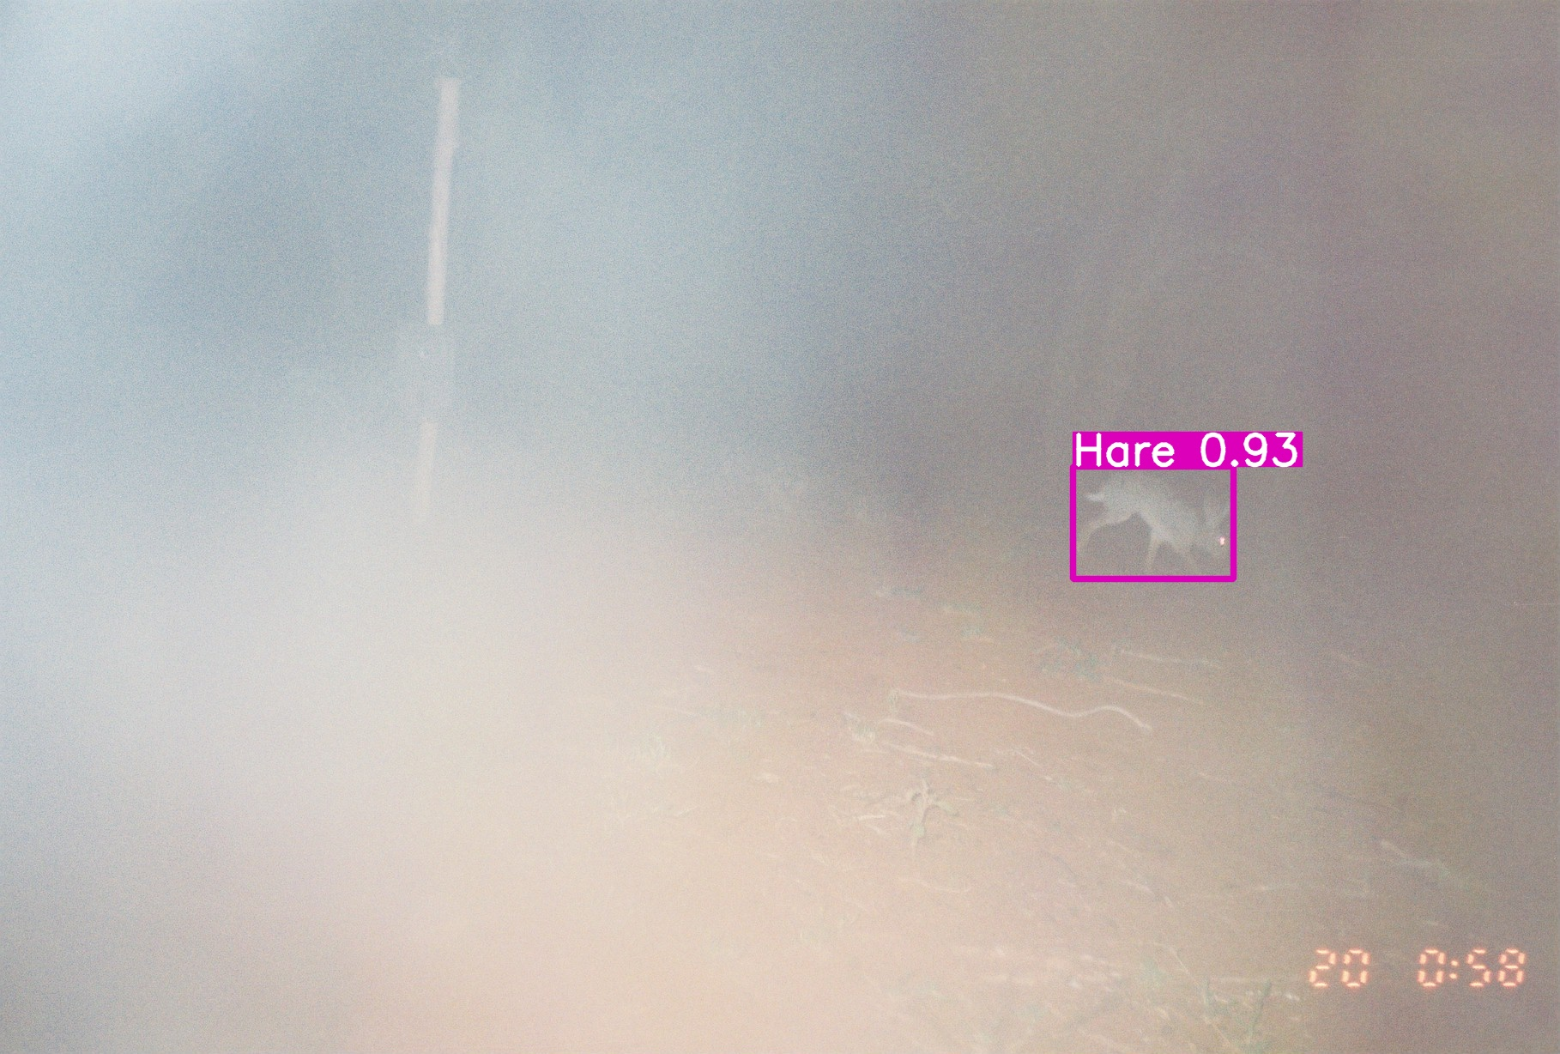
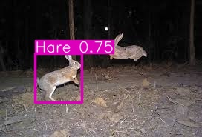
RESULTS

Slide 39
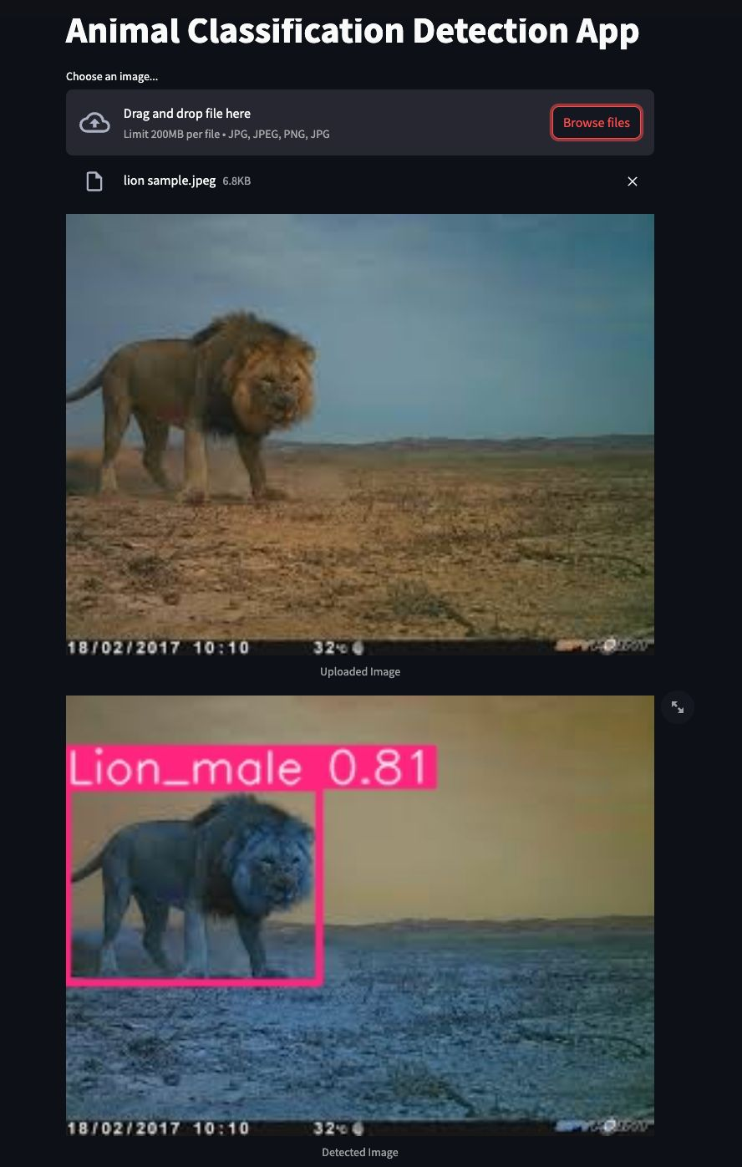
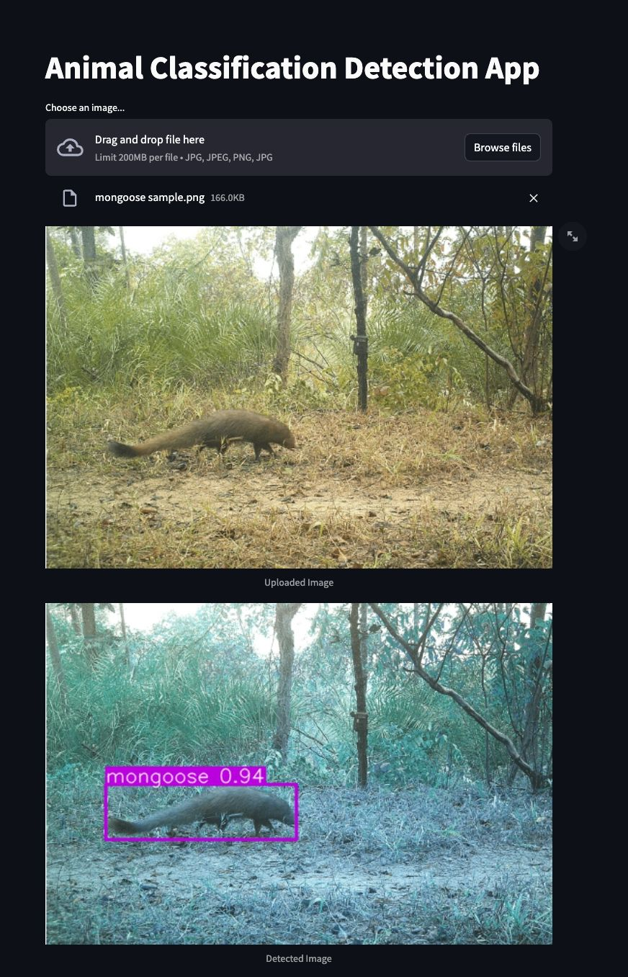
RESULTS

Slide 40
SYSTEM REQUIREMENTS
All models were trained an validated on a high-performance HP Inc. workstation with the following specifications:
System Model: HP Z4 G5 Workstation Desktop PC
Operating System: 64-bit Windows, x64-based architecture
Processor: Intel® Xeon® w5-2445 @ 3.10 GHz
Installed RAM: 64.0 GB DDR5 (4800 MHz)
Graphics Card: NVIDIA RTX A6000, 47 GB VRAM
Storage: 1.38 TB SSD

Slide 41
THANK YOU🙏

